Slide 1
RAMP User Guide
HEALING PLACE CHURCH

Slide 2
AGENDA
HPC Credit Card Policy Agreement
Ramp Card Activation
​Ramp Processes
Assistant Mode
Reimbursement Requests
Amazon Business Perk
Questions

Slide 3
HPC Credit Card Policy
As stewards of the church’s tithe, we have done our best to establish financial procedures that make it efficient for you to operate ministries in both generosity and accountability. These policies below should be adhered to, and by signing this you agree to uphold the standards expected of a cardholder.

Slide 4
HPC Credit Card Policy
Transactions populated in your Ramp account must have all requirements met within 3 days of purchase, or your card will automatically be locked. Ramp will notify you daily of incomplete transactions. Once you fulfill the requirements, your card will automatically be unlocked. There is no need to contact Finance to unlock your card.
Cards will lock (suspend) 3 days from the swipe/point of purchase(authorization) if requirements for your transaction are not met.
Example) If you make a purchase at 10am on Friday, the card will lock at 12pm on Sunday. If your purchase is at 2pm on Friday, the card will lock at 12pm on Monday. Email communications consider this (you will receive a 24-hour reminder at noon the day before locking). Managers are notified when a cardholder on their team has flagged transactions, or their card is locked.
Requests to increase your spending limit on your card or to request a virtual card must be submitted and approved by your Manager in Ramp by Tuesday at 5pm, to be approved by Finance on Wednesdays. Please plan accordingly to ensure that you have funds when you need them.
Cardholders should submit approved reimbursements in Ramp. You will need to enter your bank account information to be reimbursed via ACH. Reimbursements for purchases made due to card suspension or insufficient funds on your Ramp card will not be reimbursable.

Slide 5
Activate your ramp card
There are 3 ways to activate your physical Ramp card:
Activation through Ramp.com
2. Activation via SMS
3. Activation via Mobile App

Slide 6
Three ways to activate Your Physical Ramp CArd

Slide 7
Three ways to activate Your Physical Ramp CArd

Slide 8
Three ways to activate Your Physical Ramp CArd

Slide 9
Ramp Processes
Receipt Submission
Transaction Coding
Spend Increase Requests
Virtual Card Requests
Linking Virtual Cards

Slide 10
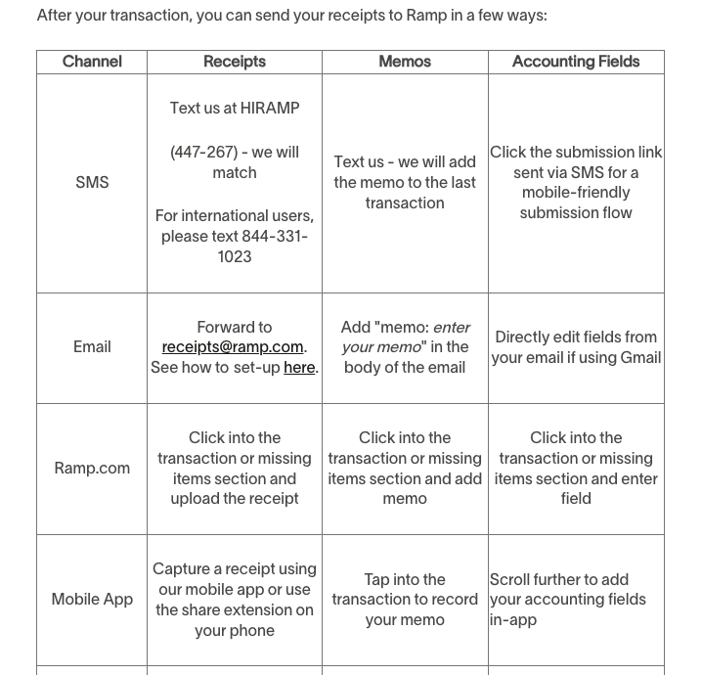
Receipt Submission

Slide 11
Receipt FYI's
Receipts are required for every transaction AND refund. If you don't receive a refund receipt and only a confirmation of your refund, submit what you have.
Please notify finance if Ramp is not accepting the receipt you are attaching for your refund.
If you reuse a receipt, the software will flag your transaction and your manager and admins (finance) in Ramp will be notified.
If you attach an incorrect receipt to a transaction, the software will flag your transaction and your manager and admins (finance) in Ramp will be notified.

Slide 12
Transaction Coding
Ramp Name: | What this means to you:
Intacct Location (required) | Campus
Intacct Department (required) | Ministry Department
Memo (required) | Description of purchase/charge - be clear. Imagine someone who has no idea what your job entails is reading your memo. They should be able to understand what you purchased or what your expense is for. When in doubt – think about complete sentences. :)
Intacct Category (required) | Expense type (supplies, meals and entertainment, subscription, etc.)
Intacct Class (required) | Fund (Unrestricted, Temporary Restricted, etc. - Unrestricted applies most of the time)
Intacct Project | Event Name/Project Name (typically for central support events and required for Temporary Restricted funds)
Intacct Employee (required) | Cardholder name

Slide 13
Flagged Transaction Notification

Slide 14
Spend Increase Request
You can request an update to existing cards to increase your spending ability.
Log in → Click on Card → Edit Card Details →Enter your updated card details → Save Changes → Enter reason for increased limit (text memo) → Select "Reset amount limit change at the end of the current period?" → Send Request
If you have a budget of $100/month and you need an additional $100, the amount you will submit your request for is $200.
Requests are sent directly to your manager for approval, then to finance for final approval.

Slide 15
Virtual Card Request
Great for ministry leaders tracking more than one budget. You can have a virtual card for each ministry to help separate budgets for easier tracking. If you need a virtual card, you must contact finance to create one for you. Please keep in mind that our weekly deadline (Tuesdays by 5pm) applies to virtual card requests as well.
A virtual credit card, just like a physical card, is tied to the account holder’s line of credit. It provides the same access and includes the same identifying information. However, it doesn’t have the same physical elements, as there is no “card” so to speak. Logistical differences include:
You can’t use the card with physical POS systems, such as in brick-and-mortar stores, since there is no card to swipe or insert, however, you can add this card to your mobile wallet to conduct in person transactions
Purchases can be made online or over the phone.
You can find the information of your virtual card within the Ramp, on both mobile and web. Click the card to reveal:
the full payment card number (PAN)
CVV
Expiration

Slide 16
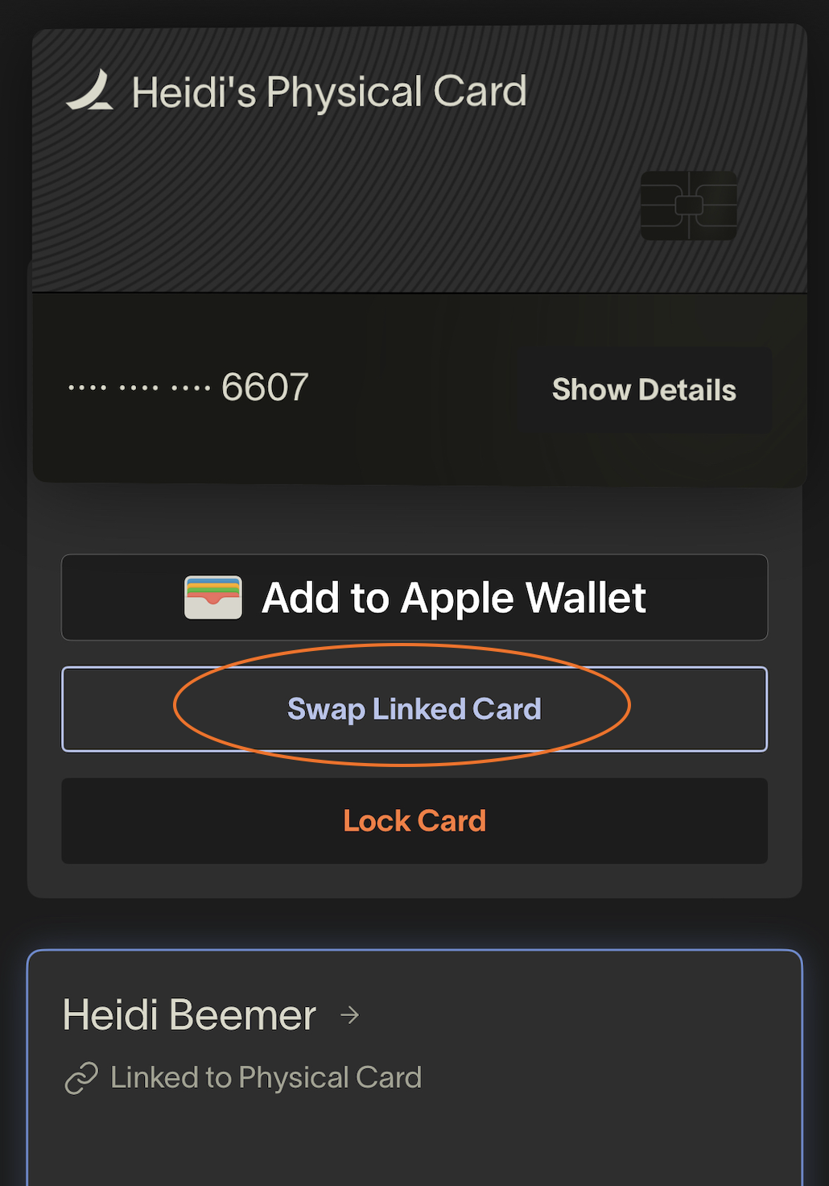
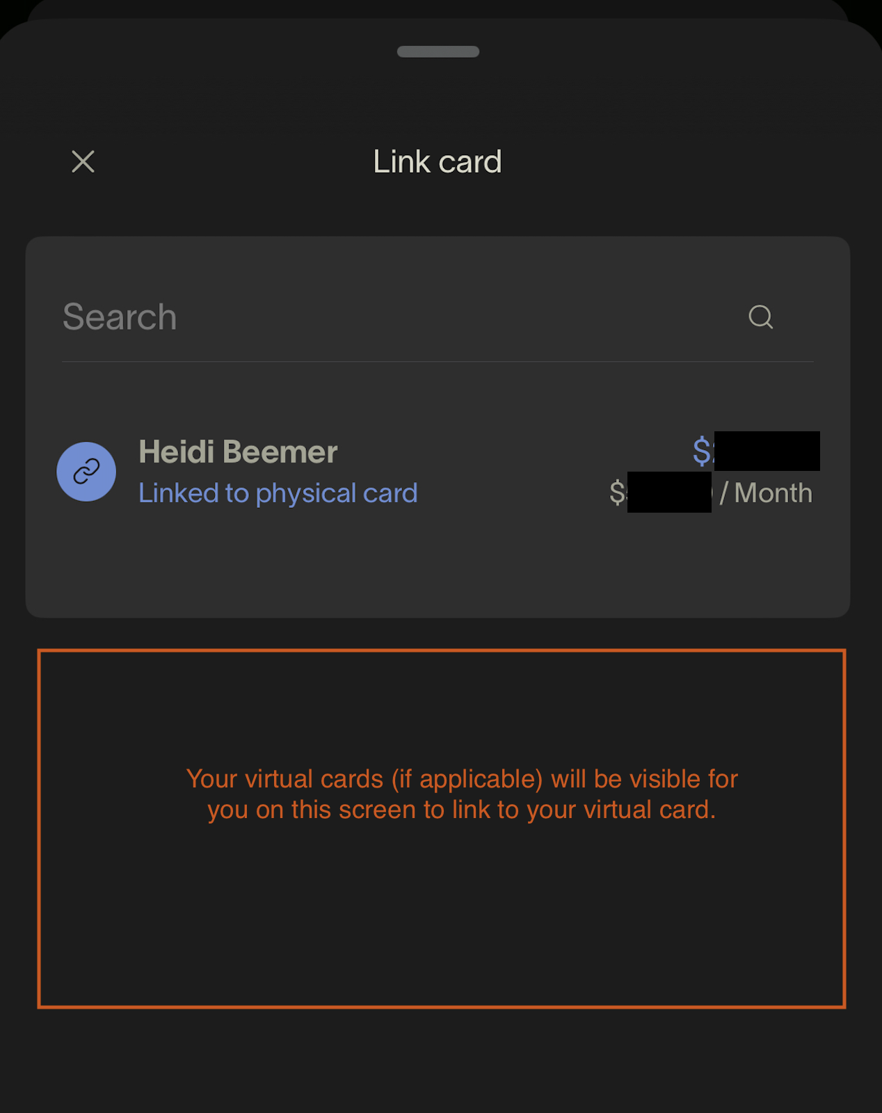
Linking Virtual Cards
This applies to people who would need more than one virtual card or a virtual card in general, which they need to link to a physical card.

Slide 17
ASsistant Mode
The Assistant role is for an individual (e.g. an Admin Assistant) to perform certain tasks on behalf of another user (e.g. an Admin Assistant).
Assistants can be assigned by Finance only.
Assistants can do the following on behalf of their assigned user(s):
View transactions
Submit receipts
Fill out the transaction memo
Submit/edit reimbursements
What can the Assistant user see?
The Assistant can see the transactions and related information for the user(s) who have assigned them as Assistant.
Assistants are not able to see activity beyond their designated scope, such as card numbers and the transactions of other users that the user(s) they're assisting can see, even if they are assigned to an Admin user.
Assistants will also be notified of their manager's missing items in their weekly "Missing Items" email.

Slide 18
Reimbursement Requests
Cardholders should submit approved reimbursements in Ramp. You will need to enter your bank account information to be reimbursed via ACH. Reimbursements for purchases made due to card suspension or insufficient funds on your Ramp card will not be reimbursable. (Finance Policy)
Please get approval from finance before you make a purchase on your personal card if you are unsure if the purchase will be reimbursable.
Reimbursement requests are submitted to managers for approval, then finance for final approval.
You can only submit reimbursements for yourself, and you will be reimbursed via ACH (bank deposit). There will be not be a physically printed check.
Non-cardholders and volunteers needing to be reimbursed will need to be
input via Sage Intacct.

Slide 19
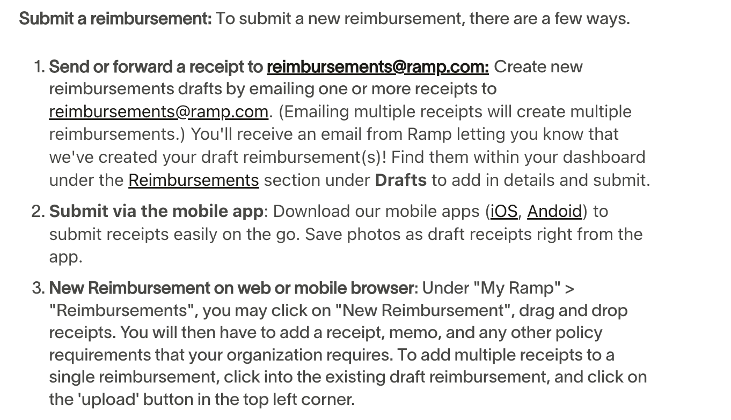
Reimbursement Requests

Slide 20
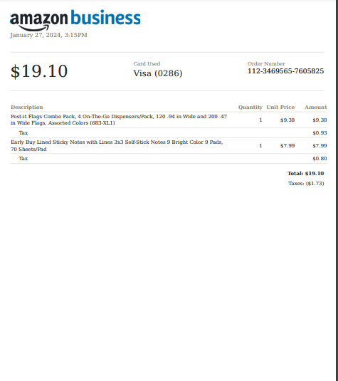
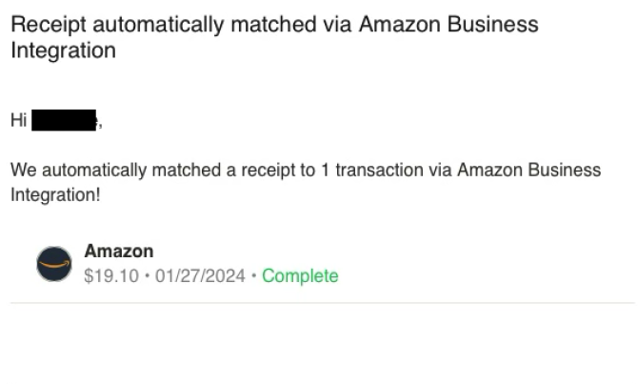
Amazon Business
All HPC staff using Amazon for ministry purchases should be utilizing their Amazon Business account for business related purchases ONLY. If you do not have an account and believe you need one, please email deedee.rentz@healingplacechurch.org.
When you use your Ramp card (physical or virtual card) for Amazon business purchases, there is no need to forward your receipts or upload to your Ramp account manually.
Within 24 hours, Ramp will auto generate a receipt and match it to the corresponding transaction for you.

Slide 21
Questions?
Please email finance with any questions you have regarding these processes. We are happy to provide additional training as needed!

Slide 22
Still need help?
Ramp Help Link

